Slide 1


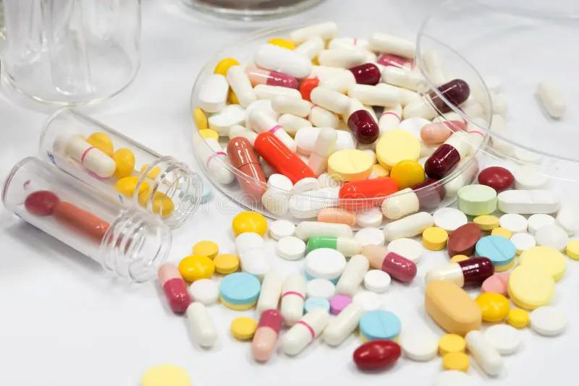

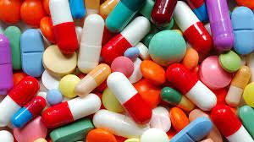



UNIVERSITY OF BASRAH / COLLEGE OF SCIENCE
M.SC.LECTURE 4
ANTIBIOTIC CLASSIFICATION AND MECHANISM OF ACTION
Department of Pathological Analyses
Presented by Prof.Dr. Saad S. Mahdi Al-Amaradi Al-Amara

Slide 2
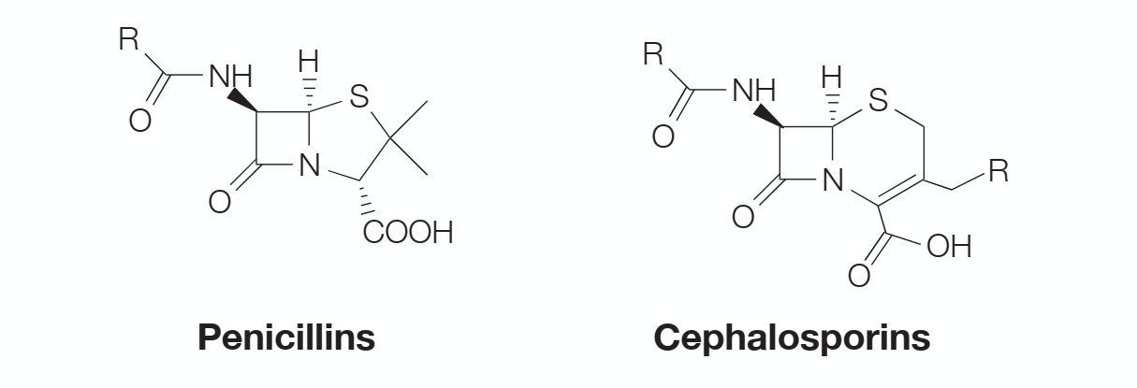
ANTIBACTERIALS THAT INHIBIT THE CELL WALL SYNTHESIS
• Antibacterial agents which inhibit bacterial cell wall synthesis
• Discovered by Fleming from a fungal colony (1928)
• Shown to be non toxic and antibacterial
• Isolated and purified by Florey and Chain (1938)

Slide 3
ANTIBACTERIALS THAT INHIBIT THE CELL WALL SYNTHESIS
• First successful clinical trial (1941)
• Produced by large scale fermentation (1944)
• Structure established by X-Ray crystallography (1945)
• Full synthesis developed by Sheehan (1957)
• Isolation of 6-APA by Beechams (1958-60) - development of semisynthetic penicillins
• Discovery of clavulanic acid and β-lactamase inhibitors

Slide 4
MECHANISM OF ACTION - BACTERIAL CELL WALL SYNTHESIS
•Penicillin inhibits final crosslinking stage of cell wall synthesis
•It reacts with the transpeptidase enzyme to form an irreversible
covalent bond
•Inhibition of transpeptidase leads to a weakened cell wall
•Cells swell due to water entering the cell, then burst (lysis)
•Penicillin possibly acts as an analogue of the L-Ala-γ-D-Ala portion of the pentapeptide chain. However, the carboxylate group that is essential to penicillin activity is not present in this portion

Slide 5
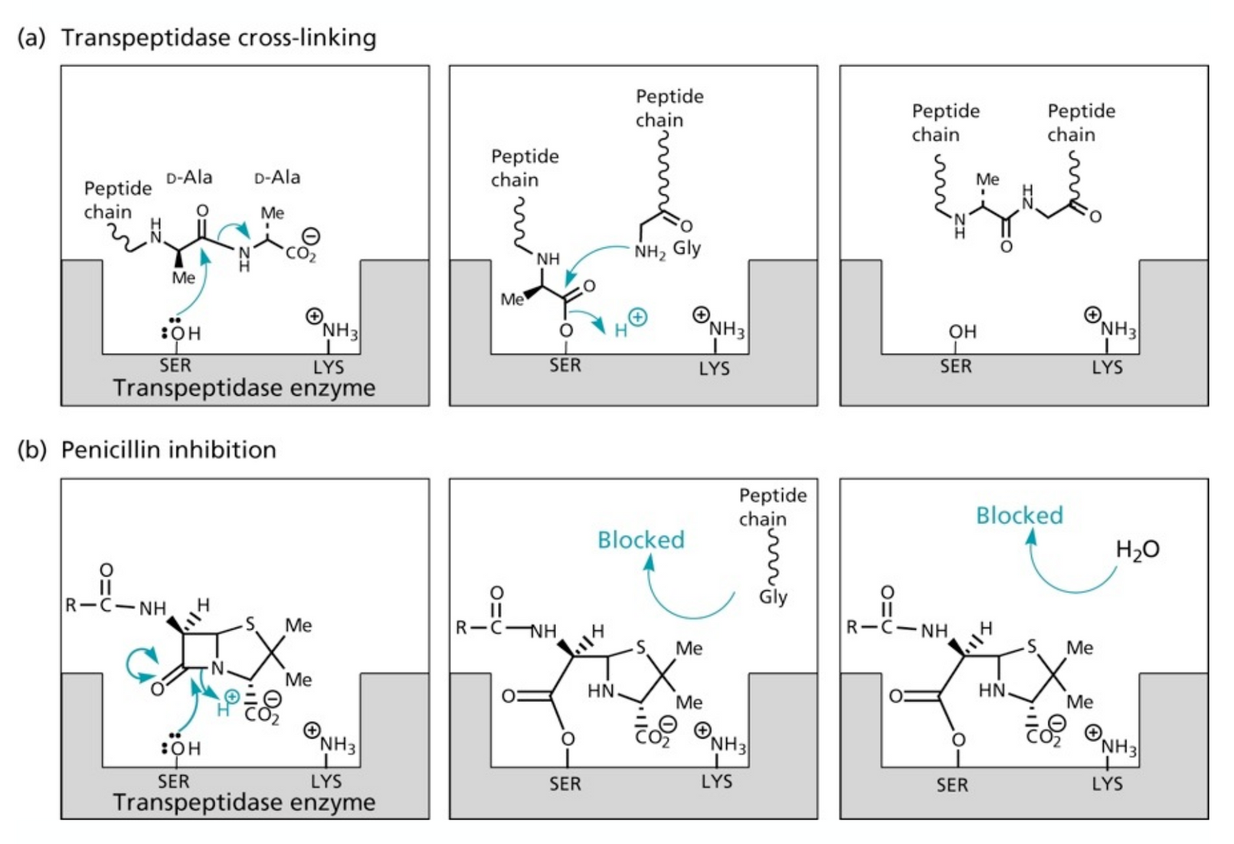
MECHANISM OF ACTION - BACTERIAL CELL WALL SYNTHESIS

Slide 6
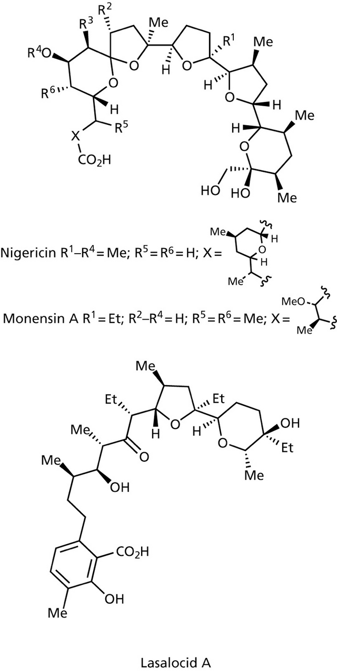
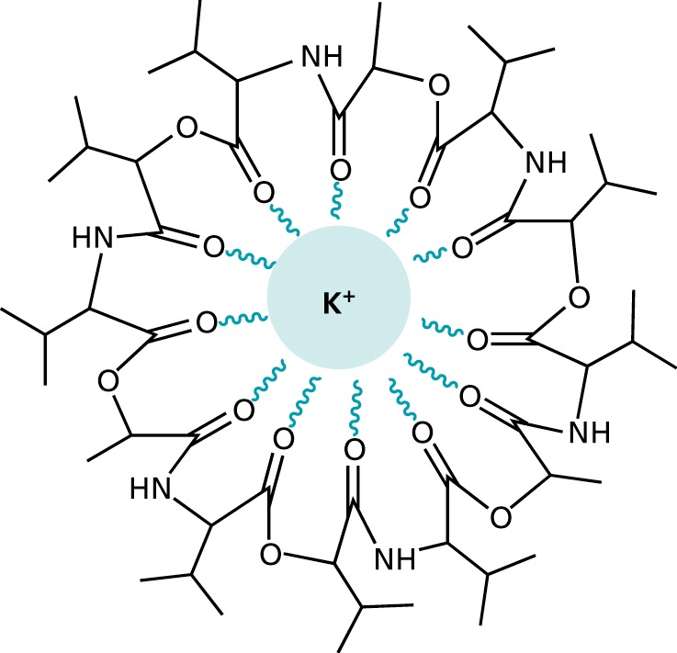
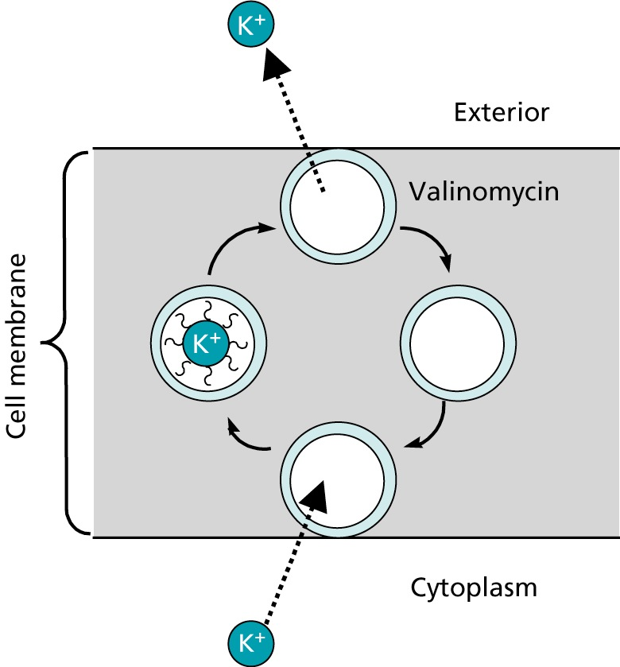
AGENTS THAT ACT ON THE PLASMA MEMBRANE
•VALINOMYCIN

Slide 7
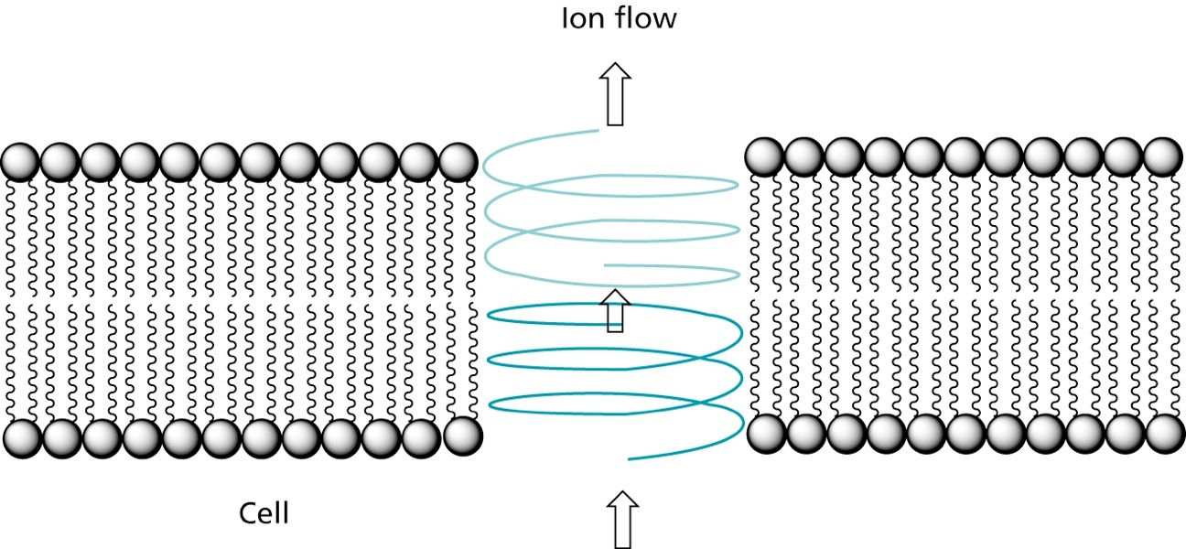
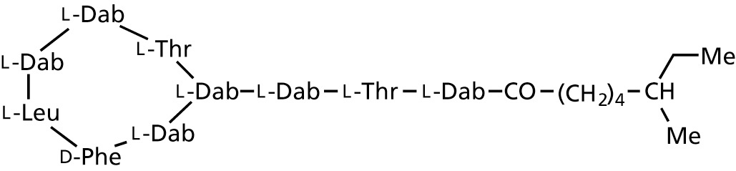
ANTIBIOTIC THAT ACT ON THE PLASMA MEMBRANE
Ionophores such as Valinomycin, Nigericin,Monensin A and Lasalocid A complex ions and transport them in a non-regulated fashion through the membrane disturbing ion concentrations intra- and extracellularly.
•Valinomycin Gramicidin A forms channels that allow passing of ions, but also of nucleosides. Another such peptide is Polymyxin B, that binds with high selectivity to the bacterial plasma membrane
Polymyxin B

Slide 8
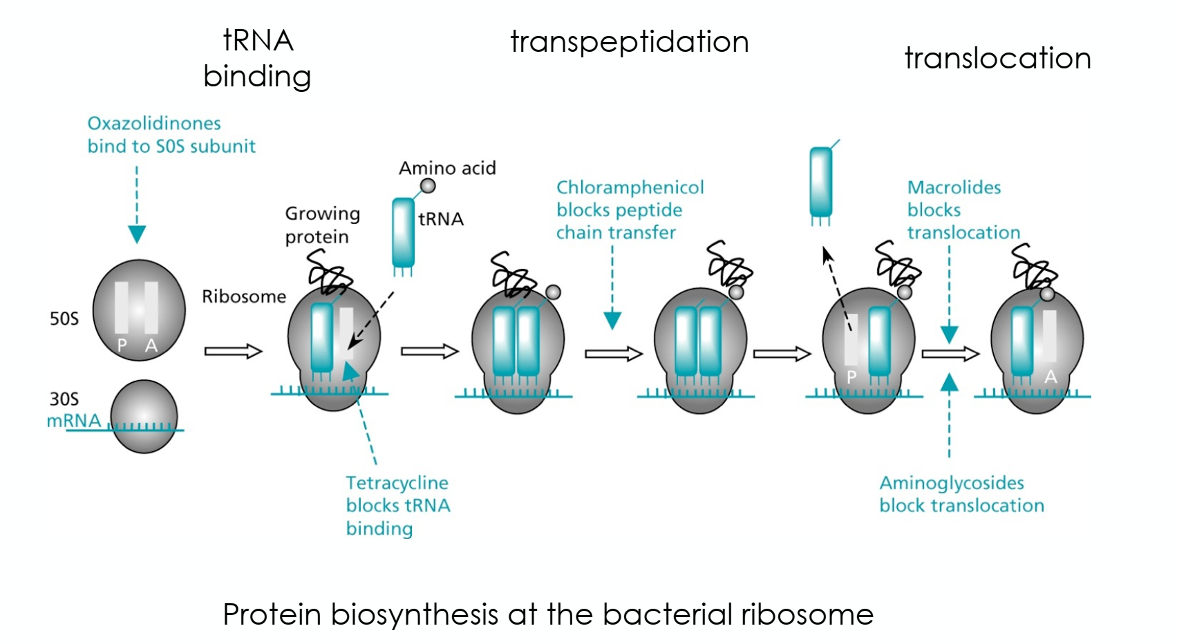
INTERFERENCE WITH PROTEIN SYNTHESIS BY BLOCKING PROTEIN TRANSLATION

Slide 9
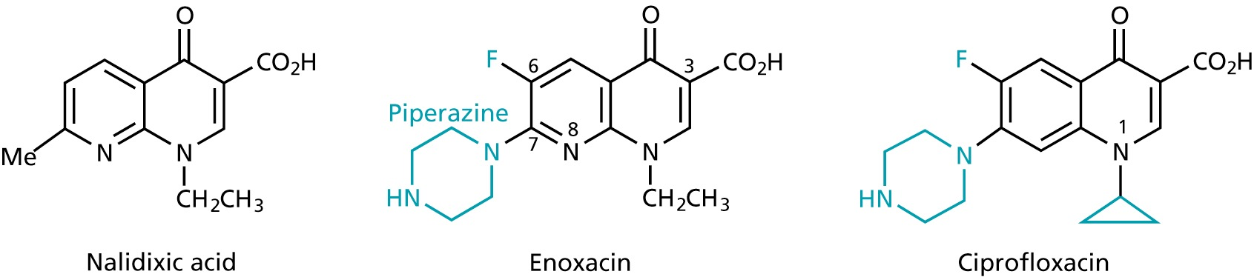
ANTIBIOTICS INHIBITING NUCLEIC ACID TRANSCRIPTION AND REPLICATION
1st
generation
• broad-band antibiotics
• inhibit the replication and transcription of bacterial DNA by inhibiting the
topoisomerases
• used for infections involving the urinary, respiratory and gastrointestinal tracts as
well as against infections of skin, bone and joints

Slide 10
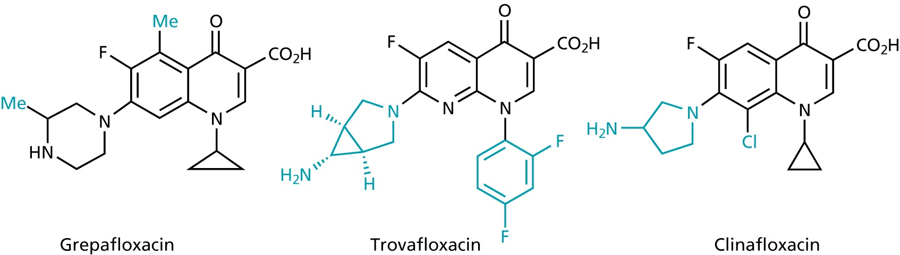
ANTIBIOTICS INHIBITING NUCLEIC ACID TRANSCRIPTION AND REPLICATION
2nd
generation

Slide 11
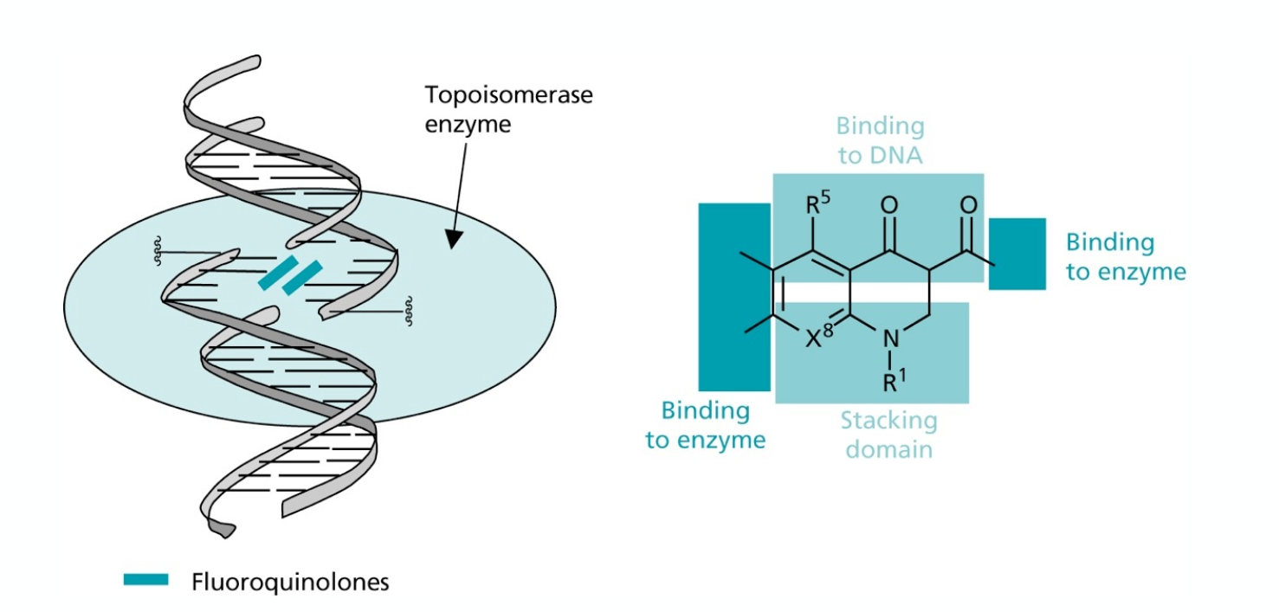
ANTIBIOTICS INHIBITING NUCLEIC ACID TRANSCRIPTION AND REPLICATION
2nd
generation

Slide 12
ANTIBIOTICS INHIBITING NUCLEIC ACID TRANSCRIPTION AND REPLICATION
•during replication, supercoiling of the DNA is removed by helicases
•the created tension is released by topoisomerases, that cut break
both strands of the DNA and rejoin them
•fluoroquinones inhibit topoisomerase IV in gram +ve bacteria with
1000 fold selectivity over the human enzyme
•in gram -ve bacteria, the topoisomerase II (DNA gyrase), that
reintroduces supercoiling after replication and transcription is
inhibited

Slide 13
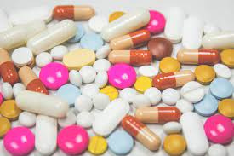
THAK
YOU!

